Slide 1
A Strategic Approach to Testing
To perform effective testing, a software team should conduct effective formal technical reviews
Testing begins at the component level and work outward toward the integration of the entire computer based system
Different testing techniques are appropriate at different points in time
Testing is conducted by the developer of the software and (for large projects) by an independent test group
Testing and debugging are different activities, but debugging must be accommodated in any testing strategy

Slide 2
Software testing strategy
Unit testing
Concentrates on each component/function of the software as implemented in the source code
Integration testing
Focuses on the design and construction of the software architecture
Validation testing
Requirements are validated against the constructed software
System testing
The software and other system elements are tested as a whole

Slide 3
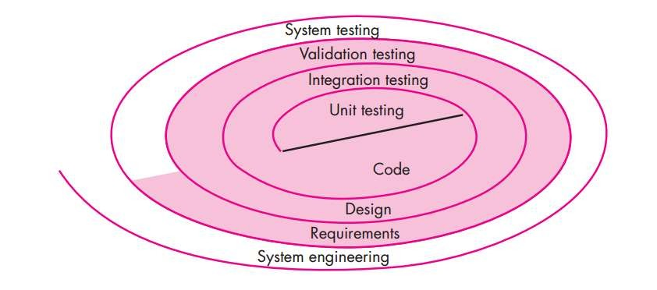
Testing strategy

Slide 4
STRATEGIC ISSUES
Specify product requirements in a quantifiable manner long before testing commences.
State testing objectives explicitly.
Understand the users of the software and develop a profile for each user category.
Develop a testing plan that emphasizes “rapid cycle testing.”

Slide 5
Test Strategies for Conventional Software
Unit testing :
Focuses testing on the function or software module
Concentrates on the internal processing logic and data structures
Is simplified when a module is designed with high cohesion
Reduces the number of test cases
Allows errors to be more easily predicted and uncovered
Concentrates on critical modules and those with high cyclomatic complexity when testing resources are limited

Slide 6
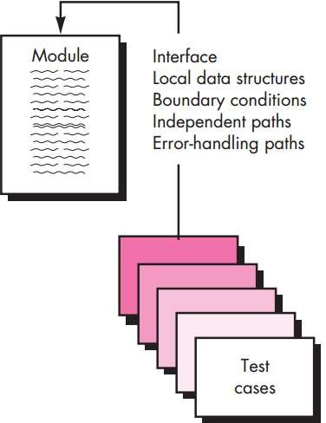
Unit testing

Slide 7
Unit testing considerations
Module interface
Ensure that information flows properly into and out of the module
Local data structures
Ensure that data stored temporarily maintains its integrity during all steps in an algorithm execution
Boundary conditions
Ensure that the module operates properly at boundary values established to limit or restrict processing
Independent paths (basis paths)
Paths are exercised to ensure that all statements in a module have been executed at least once
Error handling paths
Ensure that the algorithms respond correctly to specific error conditions

Slide 8
Integration testing
Defined as a systematic technique for constructing the software architecture
At the same time integration is occurring, conduct tests to uncover errors associated with interfaces
Objective is to take unit tested modules and build a program structure based on the prescribed design
Two Approaches
Non-incremental Integration Testing
Incremental Integration Testing

Slide 9
Non-incremental Integration Testing
Uses “Big Bang” approach
All components are combined in advance
The entire program is tested as a whole Chaos results
Many seemingly-unrelated errors are encountered
Correction is difficult because isolation of causes is complicated
Once a set of errors are corrected, more errors occur, and testing appears to enter an endless loop

Slide 10
Incremental Integration Testing
The program is constructed and tested in small increments
Errors are easier to isolate and correct
Interfaces are more likely to be tested completely
A systematic test approach is applied
Different incremental integration strategies
Top-down integration
Bottom-up integration
Regression testing
Smoke testing

Slide 11
Top-down Integration
Modules are integrated by moving downward through the control hierarchy, beginning with the main module
Subordinate modules are incorporated in two ways :
depth-first : All modules on a major control path are integrated
breadth-first : All modules directly subordinate at each level are integrated
Advantages
This approach verifies major control or decision points early in the test process
Disadvantages
Stubs need to be created to substitute for modules that have not been built or tested yet; this code is later discarded
Because stubs are used to replace lower level modules, no significant data flow can occur until much later in the
integration/testing process
1

Slide 12
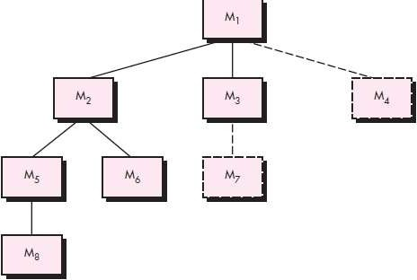
Forexample,selecting
the left-hand path, components M1, M2 , M5 would be integrated first. Next,M8 or (if
necessary for proper functioning of M2) M6 would be integrated. Then, the central
and right-hand control paths are built.

Slide 13
Bottom-up Integration
Integration and testing starts with the most atomic modules in the control hierarchy
Advantages
This approach verifies low-level data processing early in the testing process
Need for stubs is eliminated
Disadvantages
Driver modules need to be built to test the lower-level modules; this code is later discarded or expanded into a full-featured version
Drivers inherently do not contain the complete algorithms that will eventually use the services of the lower-level modules; consequently, testing may be incomplete or more testing may be needed later when the upper level modules are available

Slide 14
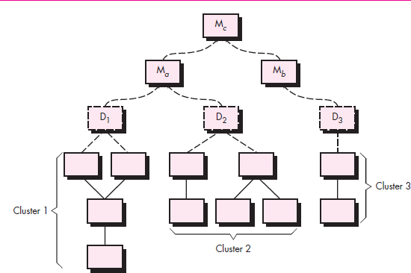
Integration follows the pattern illustrated in Figure Components are combined to form clusters 1, 2, and 3. Each of the clusters is tested using a driver (shown
as a dashed block). Components in clusters 1 and 2 are subordinate to Ma. Drivers D1and D2 are removed and the clusters are interfaced directly to Ma. Similarly, driver D3
for cluster 3 is removed prior to integration with module Mb.
Both Ma and Mb will ultimately be integrated with
component Mc, and so forth.
21

Slide 15
Regression Testing
Each new addition or modification of data may cause problems with functions that previously worked flawlessly
Regression testing re-executes a small subset of tests that have
already been conducted
Ensures that changes have not propagated unintended side effects
Helps to ensure that changes do not introduce unintended behavior or additional errors
May be done manually or through the use of automated
capture/playback tools
Regression test suite contains three different classes of test cases
A representative sample of tests that will exercise all
software functions
Additional tests that focus on software functions that are likely to be affected by the change
Tests that focus on the actual software components that have been changed

Slide 16
System testing
System testing is a series of different tests whose purpose is to fully exercise the computer based system
Recovery testing
Tests for recovery from system faults
Forces the software to fail in a variety of ways and verifies that recovery is properly performed
Tests reinitialization, check pointing mechanisms, data recovery, and restart for correctness
Security testing
Verifies that protection mechanisms built into a system will, in fact, protect it from improper access
Stress testing
Executes a system in a manner that demands resources in abnormal quantity, frequency or volume

Slide 17
Performance testing
Tests the run-time performance of software within the context of an integrated system
Often coupled with stress testing and usually requires both hardware and software instrumentation
Can uncover situations that lead to degradation and possible system failure
Deployment testing
Also known as configuration testing
It examines all installations procedures that will be used by customers

Slide 18
Verification
The process of evaluating work-products (not the actual final product) of a development phase to determine whether they meet the specified requirements for the phase.
Validation
The process of evaluating software during or at the end of the development process to determine whether it satisfies specified business/customer requirements

Slide 19
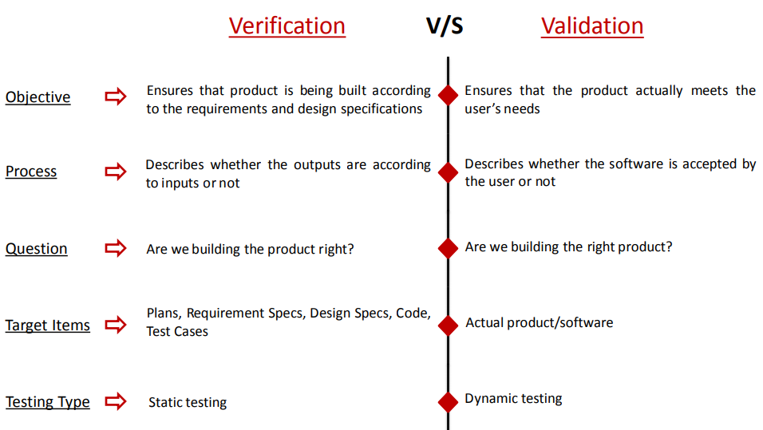

Slide 20
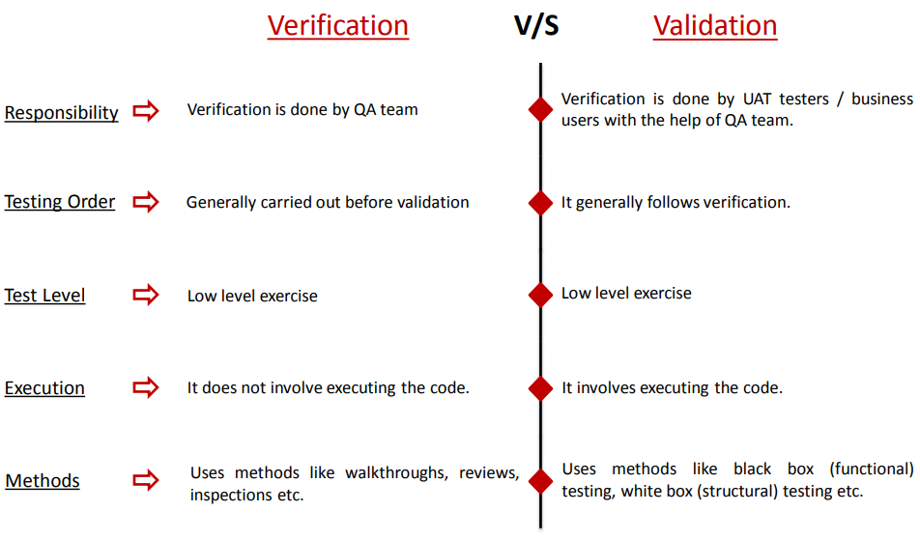

Slide 21
Verification and Validation both are necessary and complementary. Conclusion Video Tuition Let’s share knowledge
Both of them provides its own sets of Error Filters.
Each of them has its own way of detect out, the errors left in the software.

Slide 22
White Box testing
White box testing is testing where we use the info available from the code of the component to generate tests.
This info is usually used to achieve coverage in one way or another – e.g.
Code coverage
Path coverage
Decision coverage
Debugging will always be white-box testing

Slide 23
Black Box testing
Black box testing is also called functional testing. The main ideas are simple:
Define initial component state, input and expected output for the test.
Set the component in the required state.
Give the defined input
Observe the output and compare to the expected output.

Slide 24
Black Box testing
That we do not have access to the code does not mean that one test is just as good as the other one. We should consider the following info:
Algorithm understanding
Parts of the solutions that are difficult to implement
Special – often seldom occurring – cases.

Slide 25
Black Box vs. White Box testing
We can contrast the two methods as follows:
White Box testing
Understanding the implemented code.
Checking the implementation
Debugging
Black Box testing
Understanding the algorithm used.
Checking the solution – functional testing

Slide 26
Debugging
Debugging (removal of a defect) occurs as a consequence of successful testing.
Some people better at debugging than others.
Is the cause of the bug reproduced in another part of the program?
What “next bug” might be introduced by the fix that is being proposed?
What could have been done to prevent this bug in the first place?

Slide 27
Debugging Approaches
Brute force
memory dumps and run-time traces are examined for clues to error causes
Backtracking
source code is examined by looking backwards from symptom to potential causes of errors
Cause elimination
uses binary partitioning to reduce the number of locations potential where errors can exist

